Slide 1


Amazon
Group 8
Dhyey Shaileshkumar Patel (0795590)
Alejandro Rodriguez Orama (0795089)
Olabisi Fadahunsi (0801587)
Nelson Nwachia(0793347)
Abhijeet Satish Chaudhari (0792238)
Arzitha Rachakonda

Slide 2
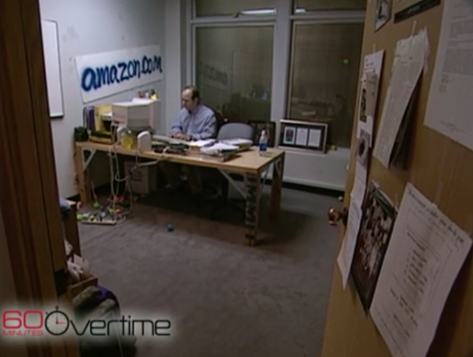
Company Overview
Founded in 1994 by Jeff Bezos as an online marketplace for books.
Initial focus on books driven by the potential of online sales.
Expanded product offerings beyond books to various categories.
Investments in infrastructure and logistics improved efficiency.
Diversification into digital streaming with Amazon Prime Video, cloud computing with Amazon Web Services (AWS), and artificial intelligence with Amazon Echo and Alexa..
Online retail roots and customer satisfaction integral to growth.

Slide 3
Current Operations
E-commerce: The world's largest online marketplace offering a wide range of products across categories, from electronics to clothing.
Amazon Web Services (AWS): Provides cloud computing services, enabling organizations to run applications and store data securely in the cloud.
Prime Membership: Subscription-based service offering benefits like fast shipping, access to streaming services, exclusive deals, and more.
Content Streaming: Streaming services like Prime Video and Amazon Music with a vast library of movies, TV shows, and music.
Devices and Technology: Development of consumer electronic devices such as Kindle e-readers, Echo smart speakers, and Ring home security products.
Logistics and Delivery: A robust logistics network utilizing advanced technologies for efficient order fulfillment and fast shipping.
Amazon's customer-centric approach, focus on convenience, and expansion into new markets have contributed to its global industry leadership.

Slide 4
Macroeconomic Environment
Factor​ | ​Examples | ​Examples
Political​ | Government policies and regulations, tax rules, foreign trade policies, and labor laws​ | Government support in areas like cybersecurity and e-commerce​
Economic​ | inflation and interest rates, exchange rate​ | ​
Social​ | society's cultural trends, including demographics, living standards, ​ | culture, population growth, religious trends, diversity of race​ ​
Technological​ | research and development of new tech, efficient delivery channels​ | new production methods, and technology​
Environmental​ | carbon footprints, pollution, global warming, climate, weather changes​ | ​
Legal​ | consumer rights, industry regulations, labor laws, product safety​ | ​
Notes:
- Amazon operates in the consumer-packaged goods (CPG) industry, which is less influenced by macroeconomic trends compared to industries like airlines or automobiles.
- However, there are still key macroeconomic factors that can impact the industry:

Slide 5
Valuation

Slide 6
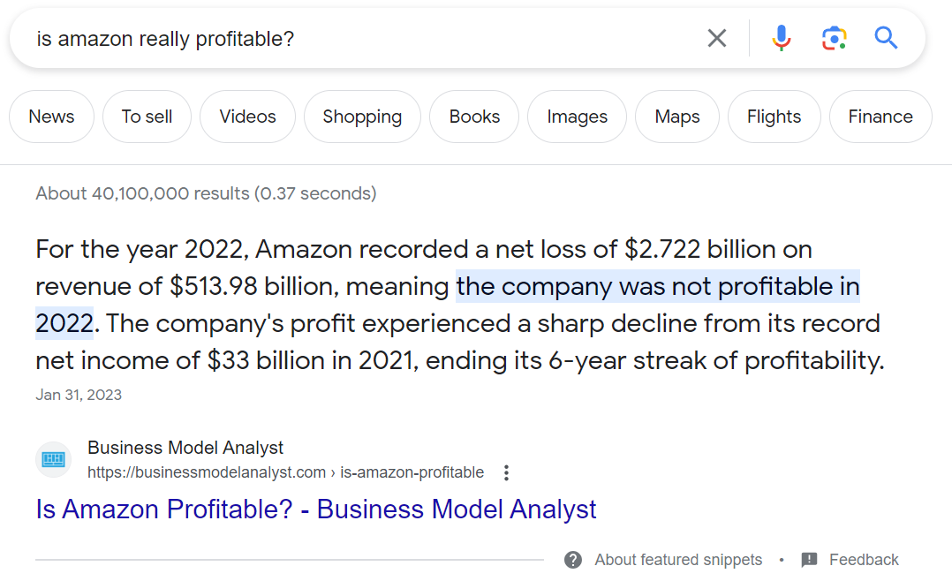
Valuation

Slide 7
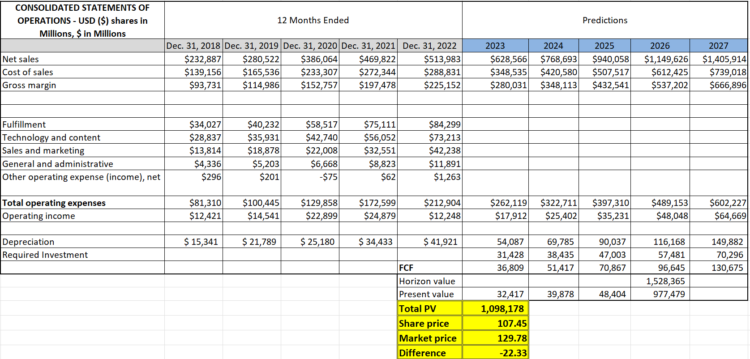
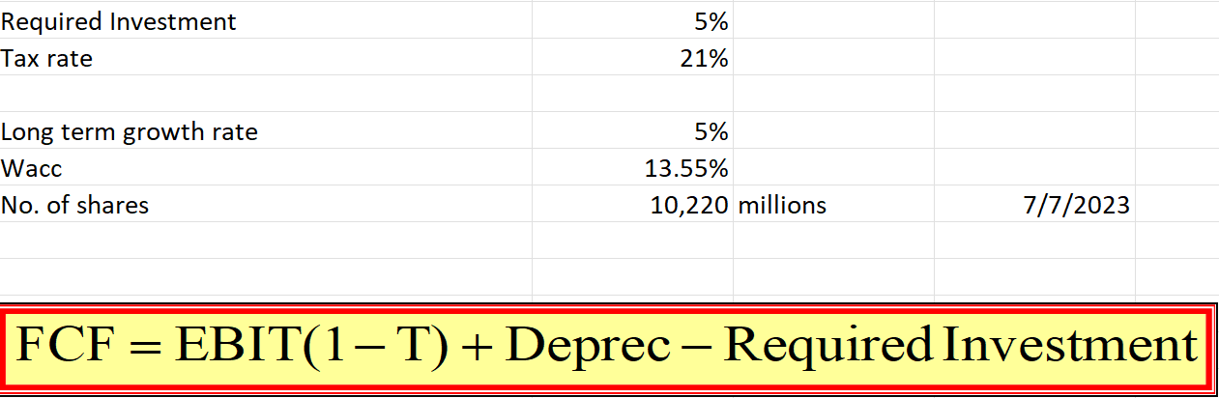
Valuation

Slide 8
CAPM AND WACC
Beta value of 1.32 for Amazon over the last 10 years indicates higher volatility compared to the broader market. Amazon's stock has experienced larger price swings relative to the overall market.
Required/expected return for investment value is -0.21% for Amazon's stock over the last 10 years indicates a negative average return.
If Rm represents the market rate of return and is equal to 0.84%, it implies the average return of the overall market during the specified period, which in this case is the last 10 years.
For Amazon's last 10 years of data, it means that the market, as measured by the chosen benchmark, has generated an average return of 0.84% per year. This market return serves as a reference point for evaluating the performance of Amazon's stock during that period.
Amazon’s WACC = 13.55% means Amazon needs to generate a return of 13.2% on its investments to meet the expectations of its investors and creditors

Slide 9
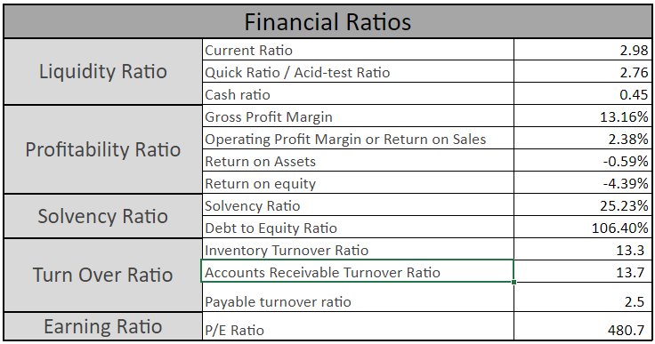
Financial Ratios

Slide 10
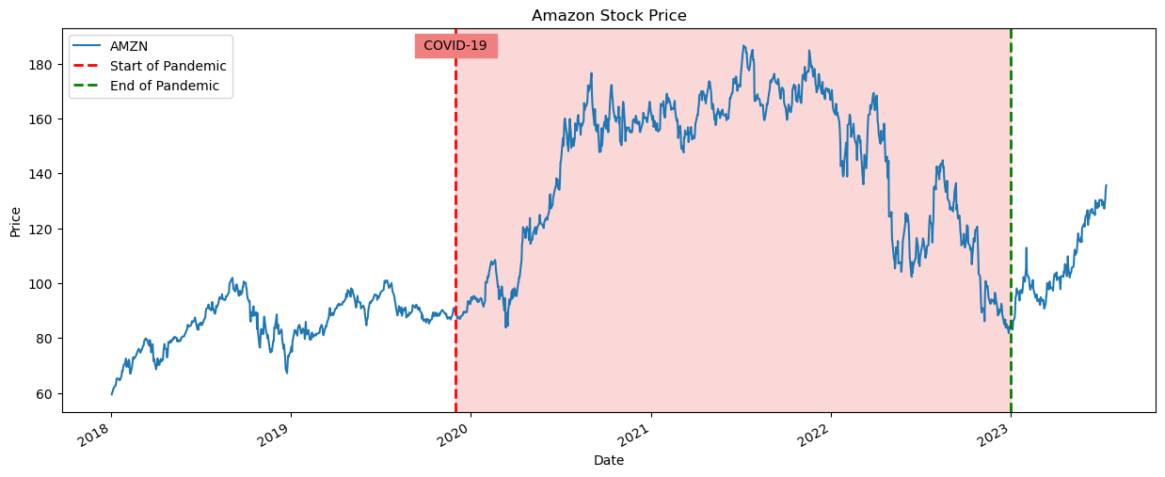
Monte Carlo Simulation

Slide 11
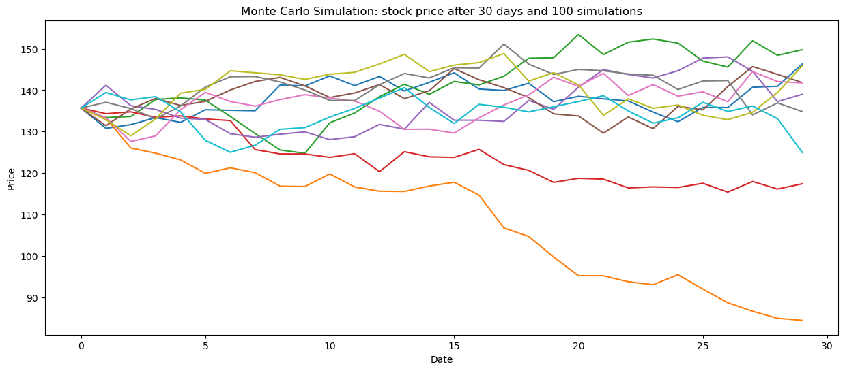
Monte Carlo Simulation

Slide 12
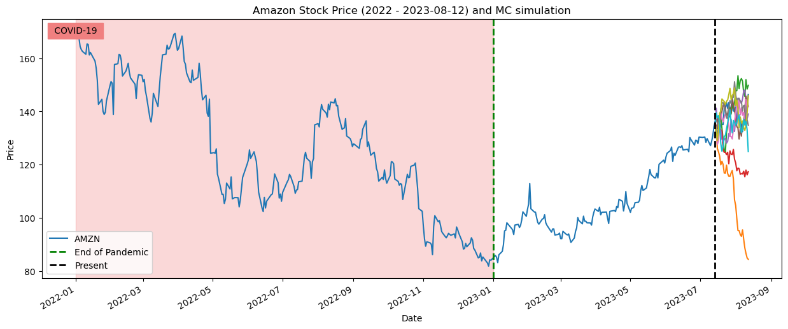
Monte Carlo Simulation

Slide 13
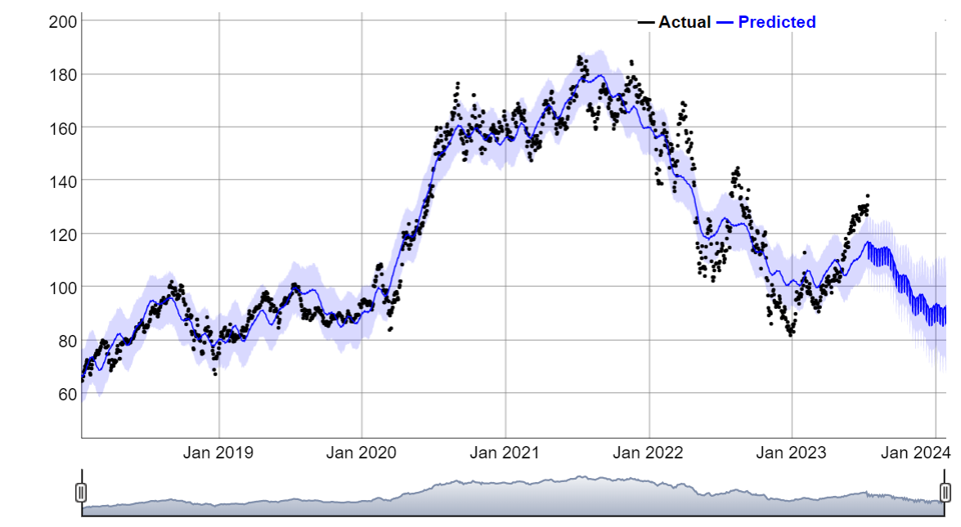
Facebook Prophet Simulation

Slide 14
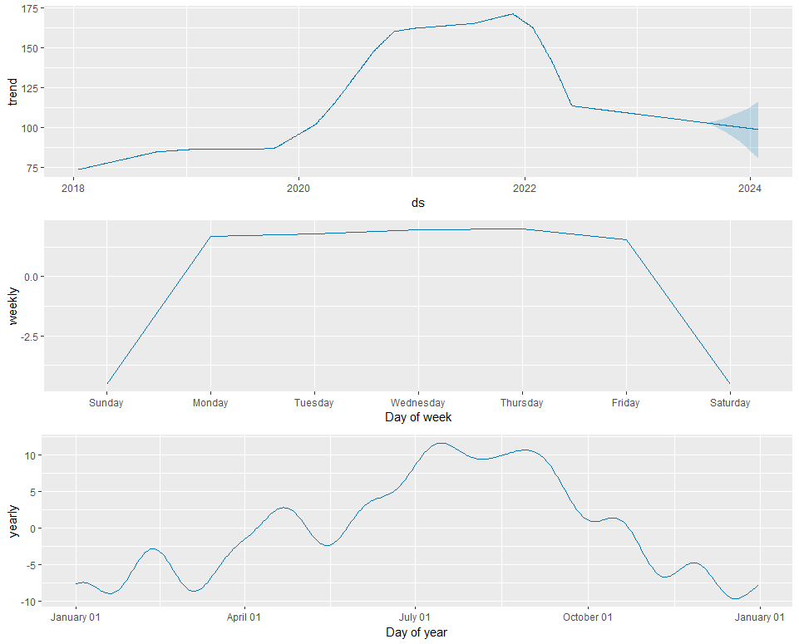
Seasonality trends

Slide 15
Recommendations
For Amazon
Consider investment opportunities that have the potential to generate returns higher than the WACC, thereby creating value for shareholders.
Amazon should capitalize on growth opportunities aligned with Amazon's core competencies and long-term strategy
For Stockholders
COVID-19 pandemic caused a significant exponential increase in Amazon sales from 2020 to 2021. . It is important to note that the current sales numbers are not indicative of normal sales values. Therefore, we recommend selling.
As seen in the seasonality chart above, there is a notable variation between the months of July to October compared to the rest of the year. This difference can be attributed to events such as Amazon Prime Days (July 11 and 12) and the start of the school year in September. As a result, we suggest buying during the beginning or end of the year and selling during the months from July to September, which represents the high season of sales on Amazon.

Slide 16
Conclusion
Valuation:
Based on the Free Cash Flow (FCF) calculations, the calculated stock price for Amazon suggests a value of $107.45. However, the market price of Amazon's stock is currently $129.78, indicating a potential overvaluation. This may be attributed to market sentiment, growth expectations, market dynamics, and long-term investment horizons. It is recommended to closely monitor the stock price and consider factors beyond the calculated value when making investment decisions.
Financial Ratios:
Financial ratios provide insights into Amazon's liquidity, profitability, solvency, and asset utilization. Amazon demonstrates favorable liquidity with current and quick ratios above 1, indicating its ability to cover short-term obligations. Profitability ratios, such as gross profit margin and operating profit margin, reflect Amazon's effective cost management and revenue generation. However, negative return on assets and return on equity suggest areas for improvement. Solvency ratios indicate Amazon's ability to meet long-term obligations, while turnover ratios highlight its efficiency in managing assets and liabilities. The P/E ratio suggests a higher market expectation for future earnings growth.
Technical Analysis & Monte Carlo Simulation:
The Monte Carlo simulation for Amazon's stock price indicates a likelihood of staying below $150 in the next 30 days. Seasonality trends show variations in sales during the months from July to October, influenced by events like Amazon Prime Days and the start of the school year.
Recommendations:
Considering the surge in sales during the COVID-19 pandemic and the potential overvaluation of Amazon's stock, it is recommended to sell Amazon stocks. Monitoring the market sentiment, growth potential, and financial performance is crucial in making informed investment decisions. Additionally, taking advantage of seasonality trends by buying during the beginning or end of the year and selling during the high sales months from July to September can be beneficial.

